Slide 1
Refactoring
CS 3331

Slide 2
Refactoring
Refactoring is all about modifying code without changing its behavior
We do this to improve its design
We must be efficient, because we’re improving the code but not in a visible manner
Stakeholders will complain
In addition how do we assure that we have not changed the behavior?
Any change in code can introduce defects.

Slide 3
Automated Testing
A way to defined automated testing
Define tests for a system
Automatically execute tests and get results
This facilitates refactoring because:
We can assure that our refactoring did not change behavior
Saves time by being faster than creating and executing tests by hand.
Gives us a way to measure if a refactoring was successful, if after the refactoring the code passes we know it did not change the behavior of the code, but we improved its design.

Slide 4
Automated Testing Tools
Language dependent but here are a few
For Java: JUnit
For C#/.NET: NUnit
For JavaScript: JSUnit
For PHP: PHPUnit
Etc.. Find your favorite language and look it up

Slide 5
Refactorings
Martin Fowler came up with these on his book
Refactoring: Improving the Design of Existing Code
The refactorings that we will see are covered by this book
Note, this does not mean these are all the known refactorings.
There are a lot of other refactorings out there, these are just described under this book.

Slide 6
Refactorings
Techniques to address code smells
Broken into different categories
Composing Methods
Moving Features Between Objects
Organizing Data
Simplifying Conditional Expressions
Making Method Calls Simpler
Dealing with Generalization
Big Refactorings

Slide 7
Refactorings
Composing Methods (9)
Extract Method
Inline Method
Inline Temp
Replace Temp with Query
Introduce Explaining Variable
Split Temporary Variable
Remove Assignments to Parameters
Replace Method with Method Object
Substitute Algorithm

Slide 8
Refactorings
Moving Features Between Objects (8)
Move Method
Move Field
Extract Class
Inline Class
Hide Delegate
Remove Middle Man
Introduce Foreign Method
Introduce Local Extension

Slide 9
Refactorings
Organizing Data (16)
Self Encapsulate Field
Replace Data Value with Object
Change Value to Reference
Change Reference to Value
Replace Array with Object
Duplicate Observed Data
Change Unidirectional Association to Bidirectional
Change Bidirectional Association to Unidirectional
Replace Magic Number with Symbolic Constant
Encapsulate Field
Encapsulate Collection
Replace Record with Data Class
Replace Type Code with Class
Replace Type Code with Subclass
Replace Type Code with State/Strategy
Replace Subclass with Fields

Slide 10
Refactorings
Simplifying Conditional Expressions (8)
Decompose Conditional
Consolidate Conditional Expression
Consolidate Duplicate conditional Fragments
Remove Control Flag
Replace Nested Conditional with Guard Clauses
Replace Conditional with Polymorphism
Introduce Null Object
Introduce Assertion

Slide 11
Refactorings
Making Method Calls Simpler (15)
Rename Method
Add Parameter
Remove Parameter
Separate Query from Modifier
Parameterize Method
Replace Parameter with Explicit Methods
Preserve Whole Object
Replace Parameter with Method
Introduce Parameter Object
Remove Setting Method
Hide Method
Replace Constructor with Factory Method
Encapsulate Downcast
Replace Error Code with Exception
Replace Exception with Test

Slide 12
Refactorings
Dealing with Generalization (10)
Pull Up Field
Pull Up Method
Pull Up Constructor Body
Push Down Field
Extract Subclass
Extract Superclass
Extract Interface
Form Template Method
Replace Inheritance with Delegation
Replace Delegation with Inheritance

Slide 13
Refactorings
Big Refactorings (4)
Tease Apart Inheritance
Convert Procedural Design to Objects
Separate Domain from Presentation
Extract Hierarchy

Slide 14
Extract Method
Used when you have a code section that can be grouped together
Convert code fragment into method with a meaningful name
One of the most common refactorings
Smells
Duplicated Code
Long Method
Feature Envy
Comments
ExtractMethod example

Slide 15
Extract Method
Temporary Variables can cause issues
Temporary Variables are read but not changed
Pass them in as parameters
Temporary Variables are assigned
If temp variable is used only within the scope of the new extracted method, then it is not an issue-it will be moved into method
If not, you can have the method return the value of the temporary variable.
Multiple temp variables might be a limitation on what can be extracted into the method
In that case refactorings might be needed (i.e. Replace Temp with Query or Replace Method with Method Object)

Slide 16
Move Method
A method is used or will be used more by another class than the class where it resides.
Create a new method with a similar body in the class it uses most. Then remove old method or change it into a delegation.
Smells:
Alternative classes with Different Interfaces
Data Class
Feature Envy
Inappropriate Intimacy
Parallel Inheritance Hierarchies
Shotgun Surgery
MoveMethod example

Slide 17
Self Encapsulate Field
You want to reduce coupling from accessing a field directly.
Create getters and setters for the fields and only access the field via them.
Smells:
Inappropriate Intimacy
SelfEncapsulateField

Slide 18
Decompose Conditional
You have a complicated conditional statement
Extract a method that returns a Boolean out of the condition, a method for the true part and the else part.
Smells:
Long Method
Comments
DecomposeConditional

Slide 19
Rename Method
The name is not helpful
Change the name
Smells:
Comments
Long Method
RenameMethod

Slide 20
Pull Up Field
Subclasses have the same field
Move the field to the superclass
This can occur because classes were added after the hierarchy was made (there for the abstraction wasn’t correctly identified)
Or refactorings have modified the design of the code and this needs to be further refined.
Smells:
Duplicate Code
PullUpField

Slide 21
Big Refactorings
These are more extensive refactorings
They take a lot more time to do
These are more general guidelines of how to approach issues, not like other refactorings

Slide 22
Big Refactorings (4)
Tease Apart Inheritance
Convert Procedural Design to Objects
Separate Domain from Presentation
Extract Hierarchy

Slide 23
Tease Apart Inheritance
One inheritance that is doing 2 (or more jobs)
The refactoring creates two hierarchies and uses delegation to invoke one from the other

Slide 24
Tease Apart Inheritance
As changes are added you end up adding functionality to existing structure
Results in duplicated code
And makes it harder to understand
Thus making it harder to change
A way to spot this is if subclasses’ name being with the same adjective.

Slide 25
Tease Apart Inheritance
Identify the different functionality done by the hierarchy.
Decide which functionality is more important to retain the current hierarchy.
Extract Class at the common superclass to create a new class for the extracted functionality. Place it in an instance variable at the original superclass.
Create subclasses of the extracted class for each of the subclasses in the original hierarchy.
Move Method in each of the subclasses from the original hierarchy to the new extracted class.
Remove the class when it has no more code.
Use Pull up Method or Pull up Field to create the new hierarchy.

Slide 26
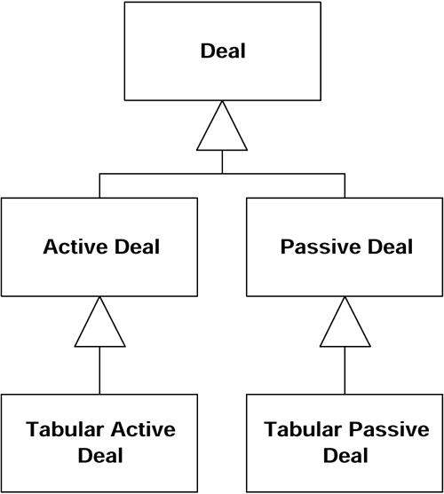
Example

Slide 27
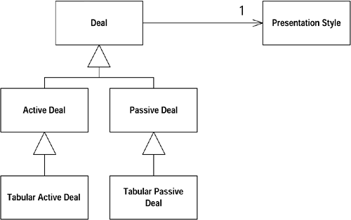
Example

Slide 28
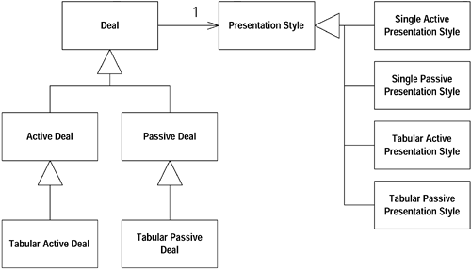
Example

Slide 29
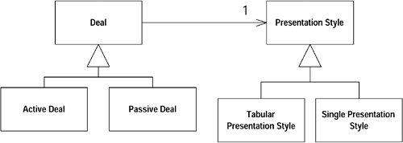
Example

Slide 30
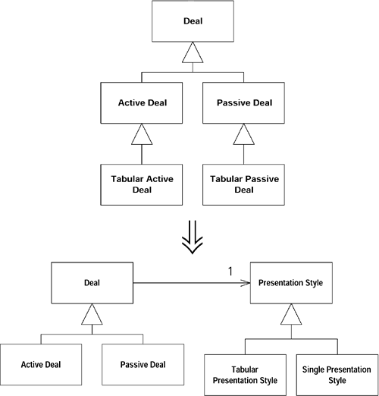

Slide 31
Refactorings..
This is an introduction, meant to give you an understanding on how this works.
Going through all 60 refactorings is beyond the scope of this class.
How confident do you feel?
Example:

Slide 32
Refactoring-Recall
“The process of changing a software system in such a way that it does not alter the external behavior of the code yet improves its internal structure.”
“A disciplined way to clean up code that minimizes the chances of introducing bugs.”

Slide 33
Why?
What happens to good systems?

Slide 34
Why?
Usually, good design first, then code second.
Over time, the code is modified
Structure of the system according to the design fades
Code sinks from engineering to hacking
Design decay

Slide 35
Refactoring is the reverse process
Take bad design
Rework it into a good design
Design occurs continuously through the life of the software.

Slide 36
Refactoring: Step 1
Build a test set
Completely automate the test set
Run the test set frequently

Slide 37
Refactoring
Continuous process
Refactor, test, refactor, test, …
Do when you need to maintain code
Refactor to a clean design
Implement change

